Slide 2
CSW66 Priority Theme
“The achievement of gender equality and the empowerment of all women and girls in the context of climate change, environmental and disaster risk reduction policies and programs." (#CSW66)
DYK? The theme for International Women’s Day, March 8, 2022 (#IWD2022)
“Gender equality today for a sustainable tomorrow”
Recognizing the contribution of women and girls around the world, to highlight the relevance of gender in climate justice and sustainable development action.

Slide 3
UN Women video: It’s Not Too Late
It’s not too late: Climate action for women, by women
WEDO Climate and Environmental Justice
https://www.youtube.com/watch?v=YJ8PqAeF-Ek

Slide 5
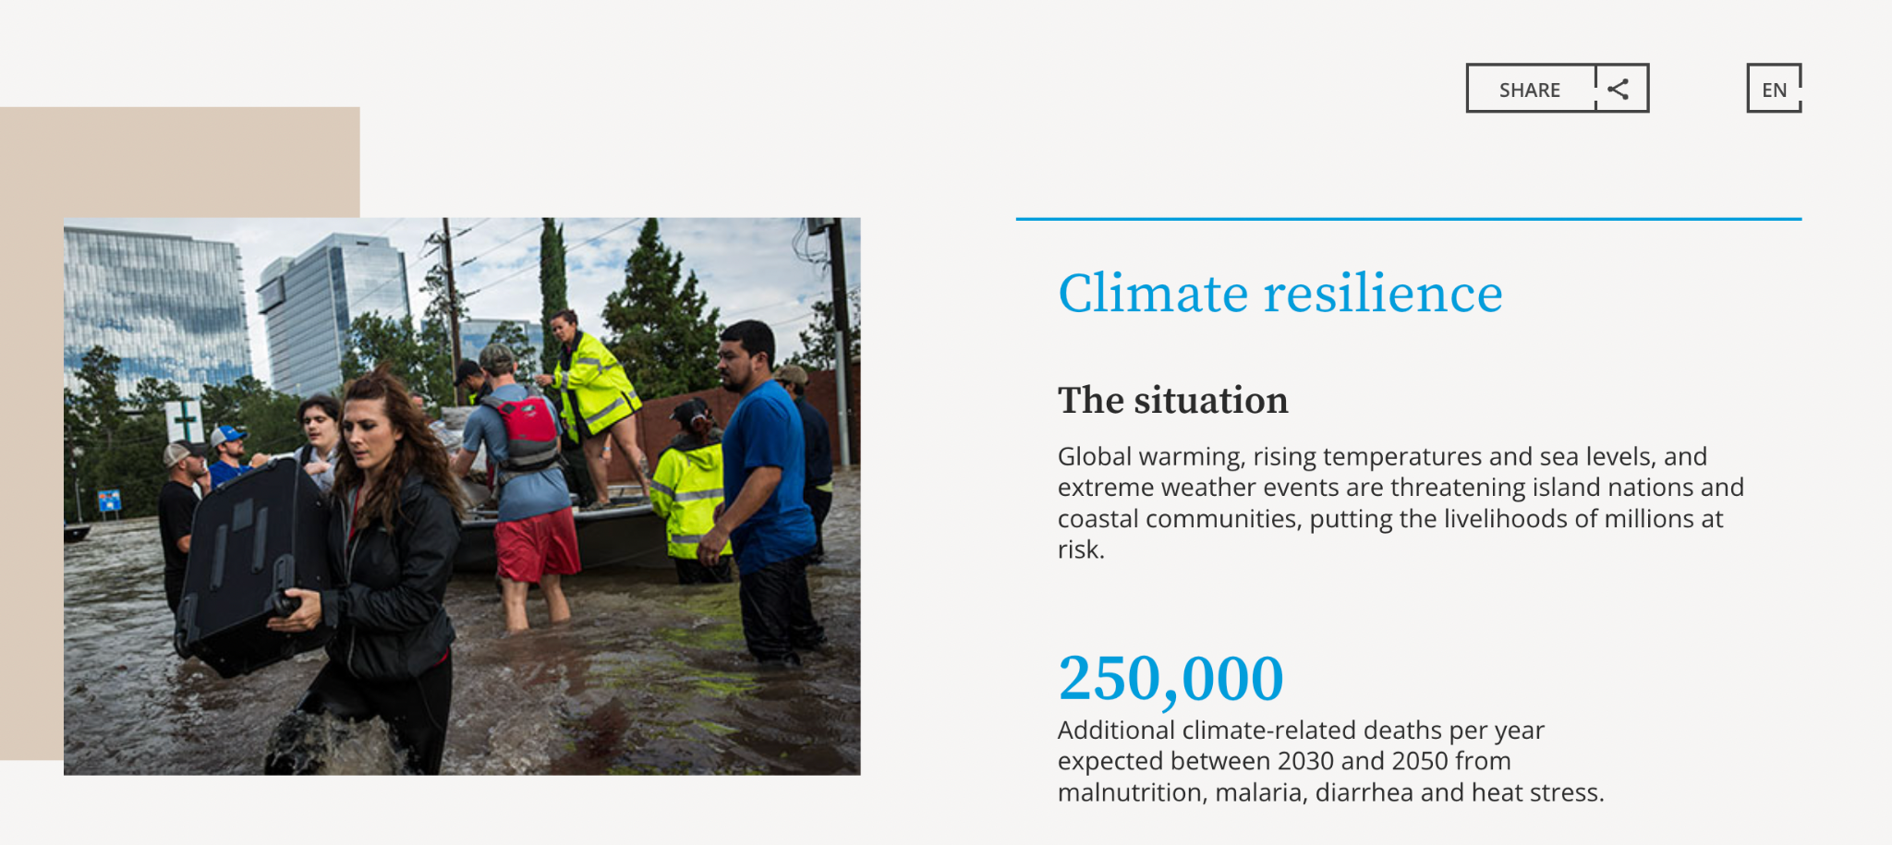

Slide 6
Gender Justice and Climate Justice
Women:
disproportionately large share of the poor all over the world
in rural areas depend on natural resources for their livelihoods
responsible for securing water, food and energy for cooking and heating.
drought, uncertain rainfall and deforestation make it harder to find these resources
face systemic disadvantages, limited access to decision-making and resources
Gender analysis must be applied to all actions on climate change processes at all levels, to identify and address women's specific needs and priorities.

Slide 8
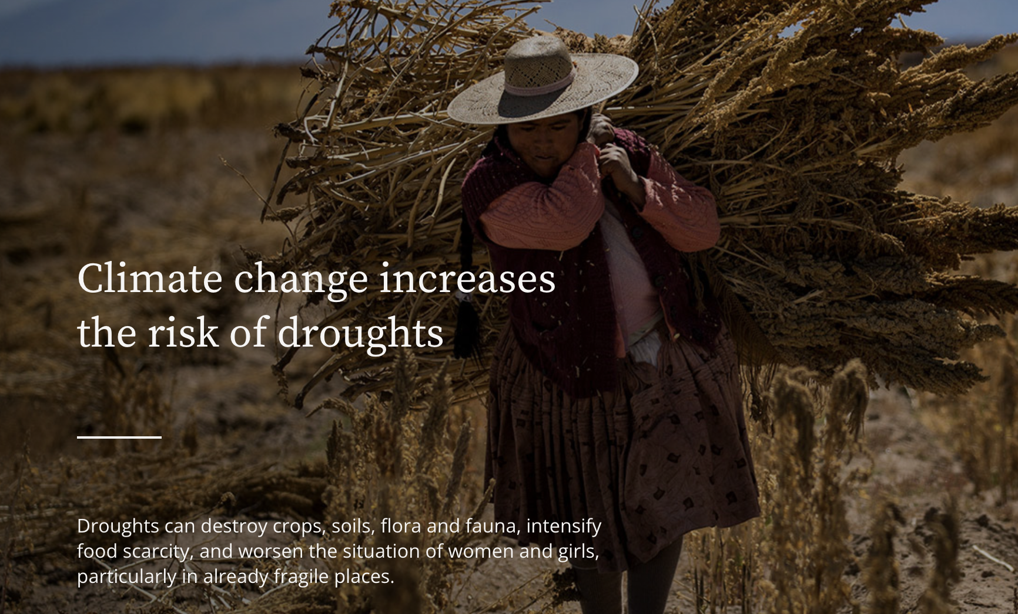

Slide 9
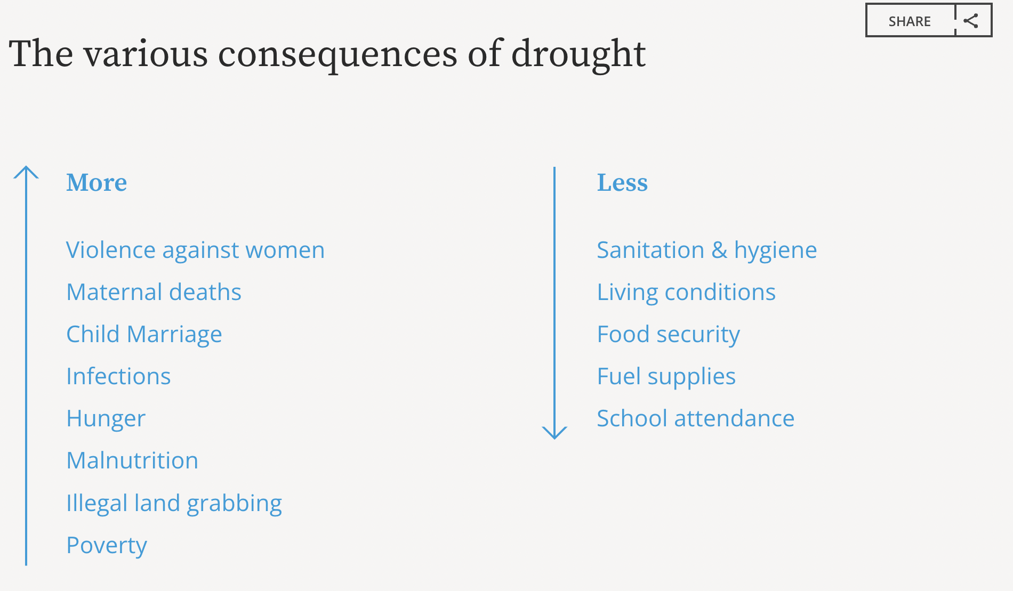

Slide 10
CSW66 Advocacy
Advocacy Research Group | NGO CSW/NY

Slide 11
CSW66 Agreed Conclusions Priority Issues
Integrate gender perspectives into climate change, environmental and disaster risk reduction policies and programmes
Promote participation and leadership of women in planning, decision-making and implementation of programs and policies
Expand gender-responsive finance
Build resilience of women and girls, education, social protection and decent work
Enhance gender statistics and data disaggregated by sex
Foster a gender-responsive, just transition

Slide 12
Gender Analysis 101
What happens to women and girls in natural disasters?
Flood, tsunami, earthquake…
(And in man-made disasters? Conflict, war…)
Climate-induced displacement
Consider the intersectionalities, particular vulnerabilities, impacts of systemic discrimination

Slide 13
March 8 is International Women’s Day
https://www.unwomen.org/en/news-stories/explainer/2022/02/explainer-how-gender-inequality-and-climate-change-are-interconnected
https://www.unwomen.org/en/news-stories/explainer/2022/03/explainer-why-women-need-to-be-at-the-heart-of-climate-action

Slide 14
Stay informed and connected
https://www.fawco.org/un-advocacy/gender-equality/commission-on-the-status-of-women/csw-blogs
https://www.facebook.com/groups/fawcoatheun
FAWCO CSW66 Whats App Group

Slide 15
