Slide 1
Region 5 Meeting - Berlin, Germany
November 11 - 13, 2016

Slide 2
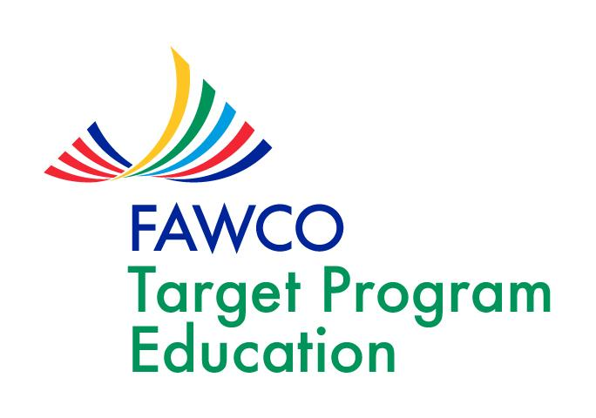
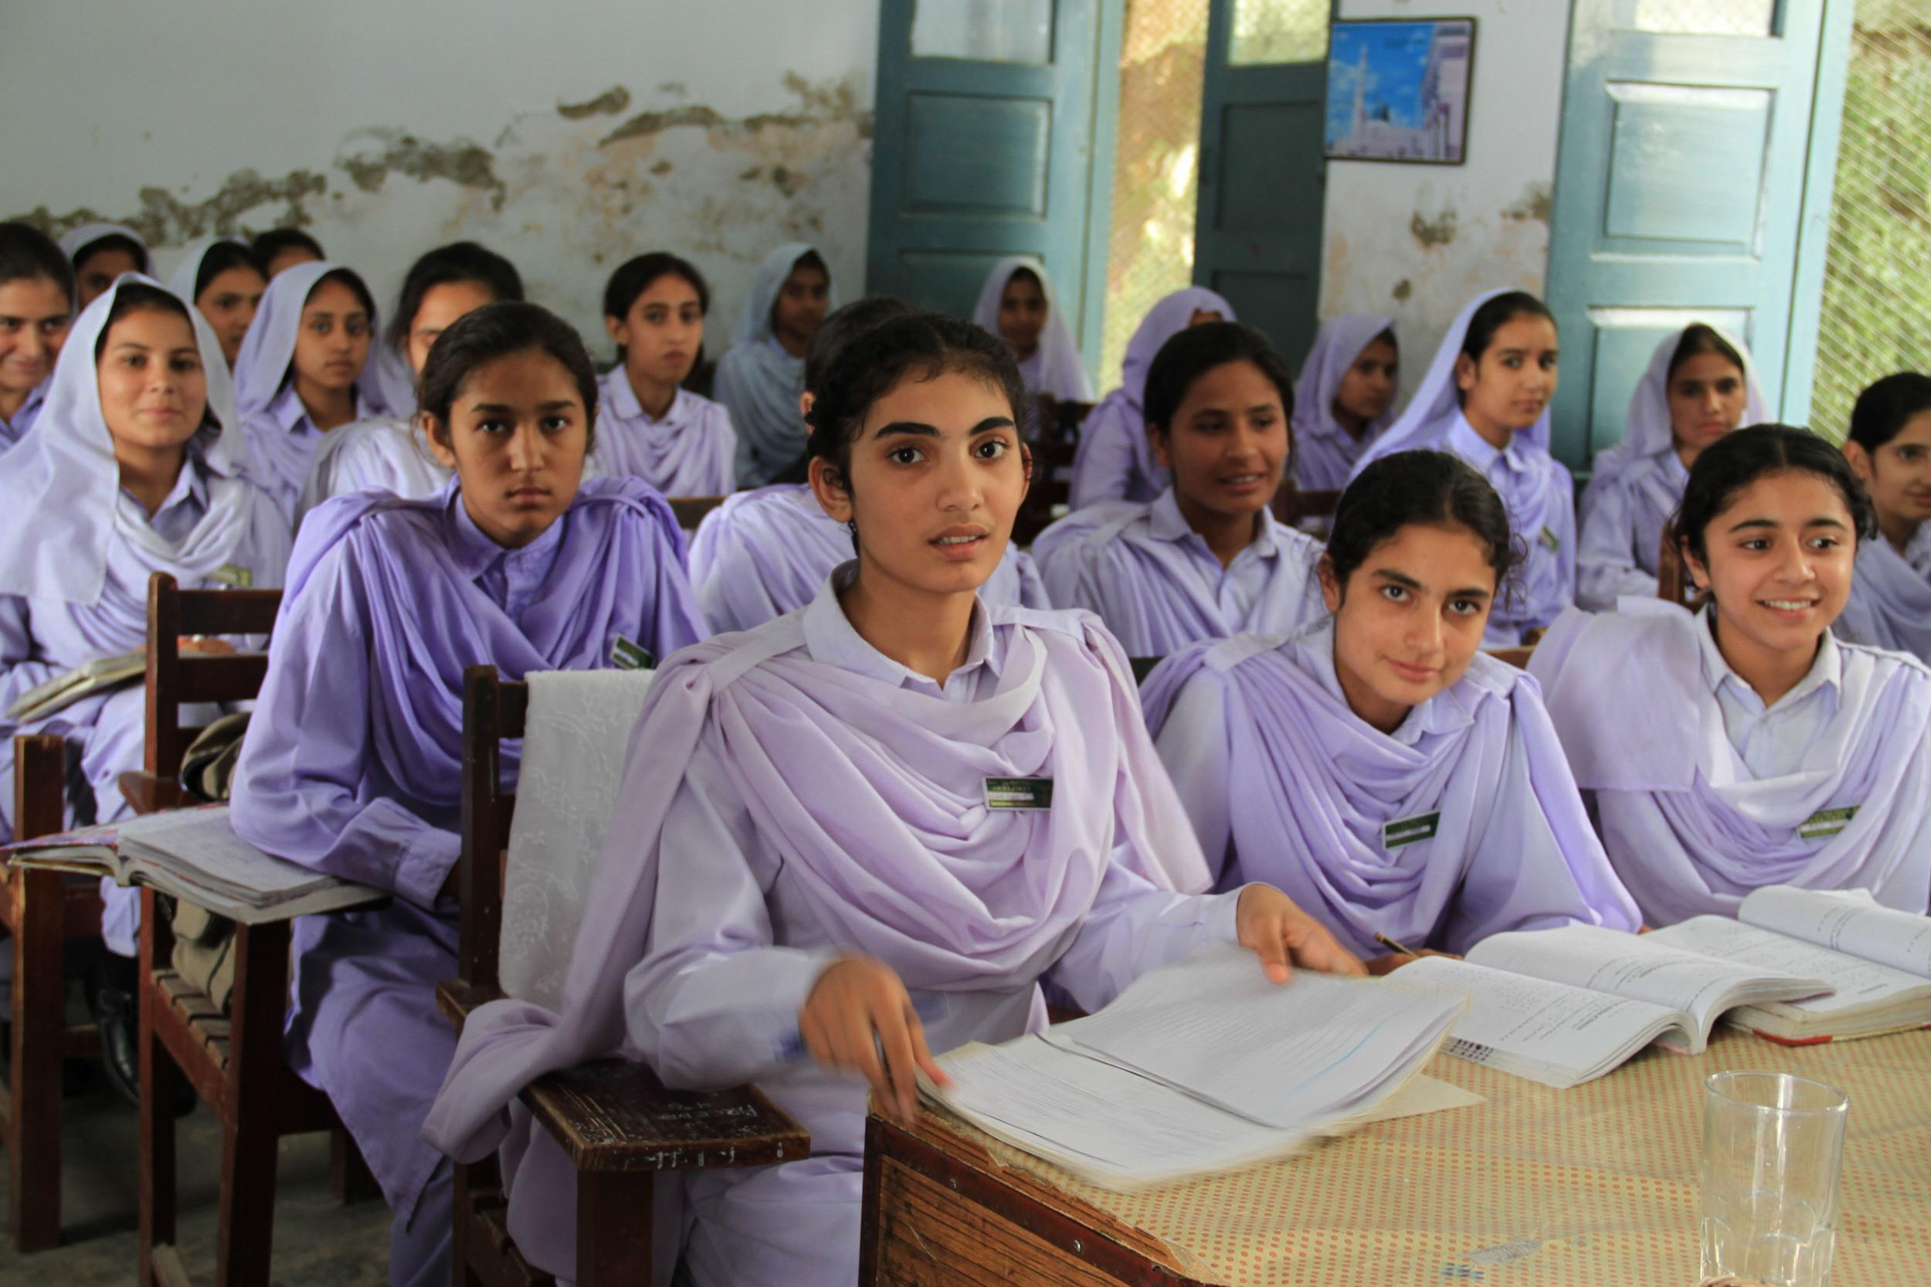
Empowering Women and Girls through Knowledge and Skills
Tricia R. Saur, Target Chair
Target@fawco.org
Wikimedia Commons

Slide 3
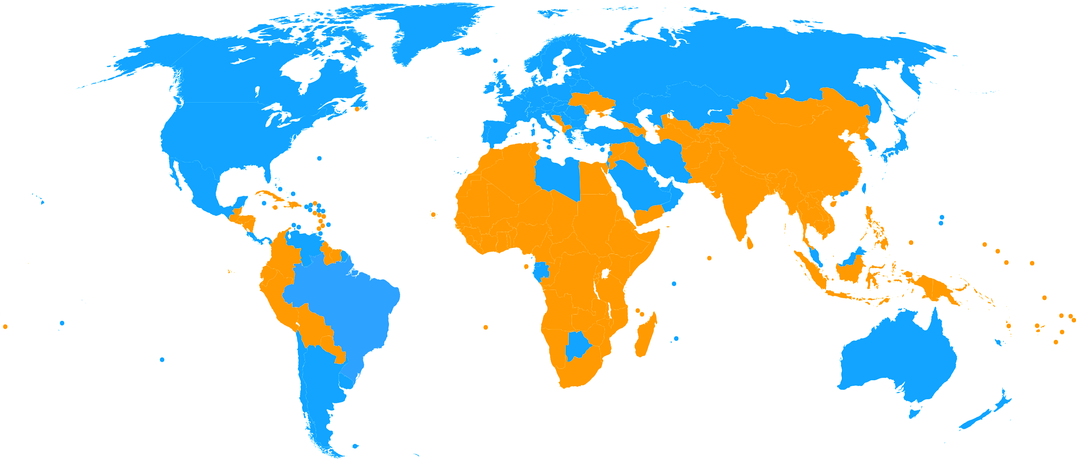
What’s preventing girls from getting an education?
Disabilities
Crisis and Conflict
Safety & Security
Water and Sanitation
School System
Global South
Teachers
Poverty
Legal Systems
Government Policies
Geographical Isolation
Cultural Norms
Ethnic Minorities
Notes:
Last spring in Frankfurt we launched our Education and Awareness Raising Campaign by touching on the barriers to education that women and girls face across the globe;
We learned that “Gender-based discrimination in education is both a cause and a consequence of deep-rooted disparities in society, … which prevent millions of girls from enrolling, completing and benefitting from education.”
UN Education for Sustainable Development

Slide 4
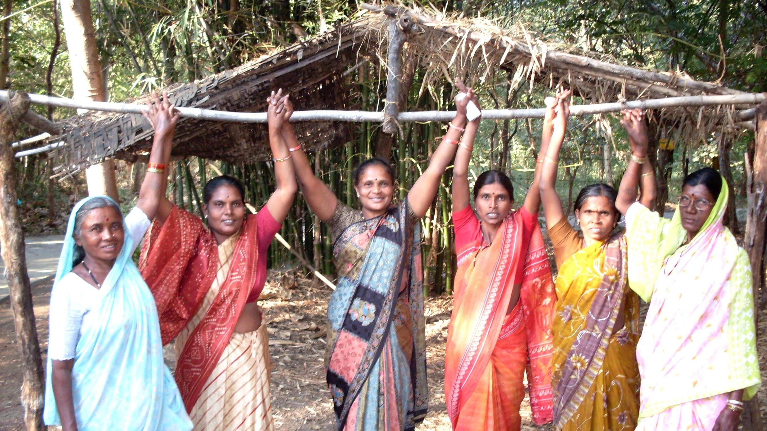
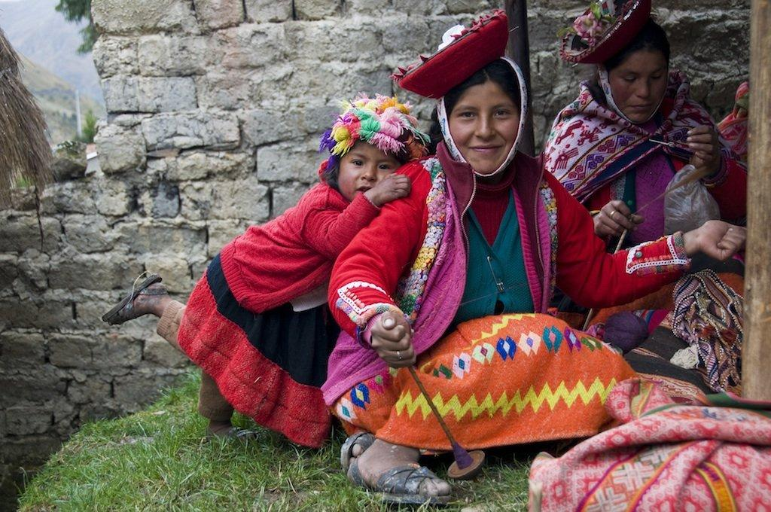
Girls’ Education
“Education is one of the most critical areas of empowerment for women. When girls are educated, they lead healthier and more productive lives. . . . An educated girl has a positive ripple effect on her health, family, community and society as a whole.”
- USAID
Source: Global Living
Source: Global Living
Notes:
We also learned that “Education is one of the most critical areas of empowerment for women. When girls are educated, they lead healthier and more productive lives. . . . An educated girl has a positive ripple effect on her health, family, community and society as a whole.”
USAID

Slide 5
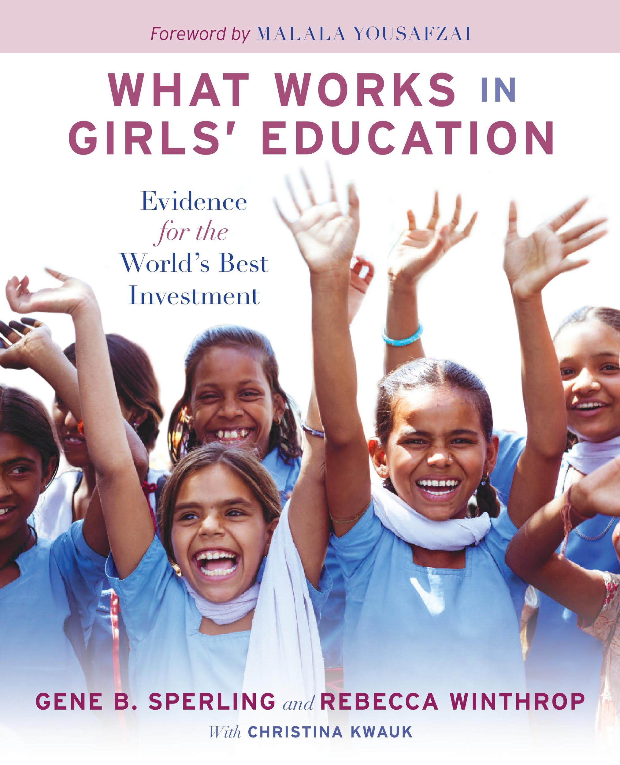
Notes:
Today I would like to talk with you about Girls Education as the world’s best investment.
And introduce you to an important book in the field, “What Works in Girls Education: Evidence for the World’s Best Investment”.
It is a publication by the Center for Universal Education at the Brookings Institute in Washington DC. I refer to them from time to time in my blog and in FB posts.
The authors, Gene Sperling and Rebecca Winthrop make the case that Girls Education is the best investment developing countries can make. Following decades of research they have come up with a Top 10 list of why this is true. And that’s what I would like to explore with you today.

Slide 6
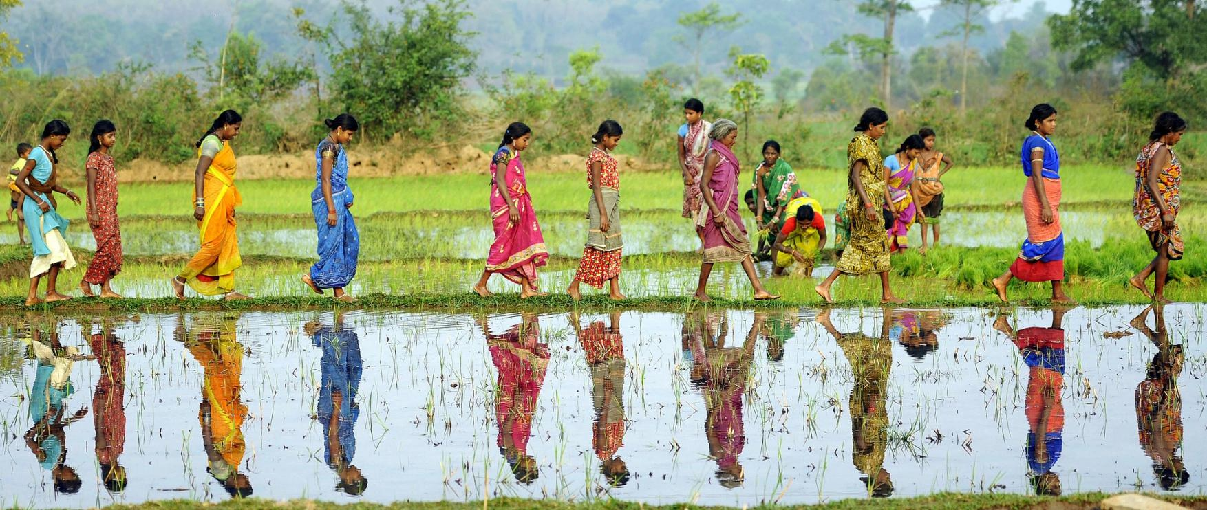
World’s Best Investment - Top 10 List
Education increases economic growth
Education leads to better wages & jobs for women
The Quality of Schooling is Important
Notes:
We are all aware that… Increasing girls educational opportunities has a positive impact on developing nation’s growth. These statistics show how significant the impact can be:
In a study of 100 countries, Dollar and Gatti found that increasing the share of women completing secondary education by 1 percent increases economic growth by 0.3 percent!
Gender education inequality explains 0.9 to 1.7 percent slower growth in East Asia, the Middle East, and North Africa.
And here is an impressive example from the agricultural sector:
The International Food Policy Research Institute (IFPRI) found that increasing educational attainment for women in Kenya could increase their agricultural output by 25 percent.
Many studies show the correlation between years of education and economic growth. But new studies emphasize that “it is the quality of schooling that is more strongly associated with economic growth—and also with sustained increase in demand for schooling.”
Education leads to better wages and jobs for women
Similar to the analysis on education and economic growth: Attending school helps increase individual earnings, but learning well and having strong skills for the labor market boosts earnings even more.
In addition to higher earnings, increased education also has the added benefit of helping women get and keep better jobs: In the developing world, many women are engaged in vulnerable employment, like in informal economies or unpaid work for their families. With education women are able to access better paying and more secure jobs in the formal economy.

Slide 7
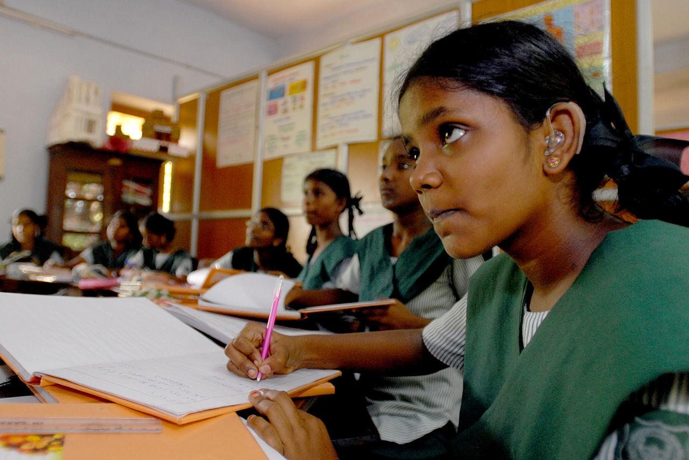
World’s Best Investment - Top 10 List
3. Education saves the lives of children & their mothers
4. Education reduced rates of HIV/AIDS and Malaria
Education is Good Medicine
Notes:
Education saves the lives of children and their mothers
The statistics here are staggering...
A 58-country study commissioned by UNESCO shows that universal primary education for girls would reduce child mortality by 15 percent; universal secondary education would reduce child mortality by 49 percent.
This I found very interesting...
A study in India found that improving infrastructure through piped water helped improve sanitation, lessen cases of diarrhea, and in turn reduce child mortality. However, for the poorest households where mothers had low levels of education, the health gains by-passed children in these households. When mothers do not have the knowledge to properly use new systems, the improvements are lost on their children.
Two more quick stats:
• Data from 108 countries over twenty years show that if every woman in the world had a primary education, maternal deaths could fall 66 percent and save an estimated 189,000 lives per year.
• In Sub-Saharan Africa, maternal mortality could fall by 70 percent, from 500 to 150 deaths per 100,000 births.
The effect of girls’ education is higher than the effect of some of the typical health interventions.
The studies also show that the reason education reduces maternal deaths is that educated mothers have fewer pregnancies and are less likely to give birth as teenagers.
Education reduces rates of HIV/AIDS and malaria
Girls’ education is often called the social vaccine against HIV/AIDS because of the significant reduction in the incidence of that disease among better-educated girls and women. Increasing girls’ and women’s education reduces their risk of contracting HIV or transmitting HIV to their babies. Better-educated women have more knowledge about how HIV is contracted and are better prepared to prevent transmission. For Example:
In Sub-Saharan Africa, just 72 percent of illiterate women know that HIV is not transmitted by sharing food, and only 52 percent know where to seek treatment, (compared with 91 and 85 percent of literate women, respectively.)
This also holds for malaria; better-educated girls and women are less likely to contract malaria, have children who are less likely to contract malaria, and are more likely to use prevention techniques, such as bed nets.

Slide 8
World’s Best Investment - Top 10 List
5. Education leads to smaller and more sustainable families
6. Education results in healthier and better-educated children
Educated Mothers have Stronger Families.
Notes:
Education leads to smaller and more sustainable families
Women with higher levels of education have fewer children, particularly once they reach secondary education. Women with higher levels of education are also more likely to give birth for the first time later in life and to have children more than two years apart. Both are important because health complications increase when children are born to young mothers and when they are born less than two years apart.
For example:
In Angola, the fertility rate of a woman with no education is 7.8 children, compared with 5.9 children for a woman with primary education and 2.5 children for a woman with secondary education or more.
In Brazil, a study found that illiterate women have an average of 6 children each, whereas literate women have an average of 2.5 children.
Smaller families are also more sustainable; for the immediate family and for the global environment! A 2011 study estimated that if we had 100% global enrollment at the primary and secondary levels, there would be 843 million fewer people in the world by 2050.
Education results in healthier and better-educated children
Educated mothers have on the whole, healthier children. This doesn’t really surprise us. For one, we know that better educated mothers are more likely to immunize their children and seek medical care. But lets look at some sobering numbers about malnutrition which we may not be familiar with...
Malnutrition is the underlying cause of 45 percent of child deaths globally. Child stunting, when children are short for their age, is typically a result of malnutrition; severely stunted children are four times more likely to die before age five than those who have sufficient nutrition.
Yet there is hope in tackling this crisis of hunger... According to the 2014 EFA Global Monitoring Report “If all women completed secondary education, 26 percent or 11.9 million fewer children, would suffer from stunting.”
(what is it about education that reduces malnutrition… 1. Knowledge about nutrition, so mothers can make better choices with limited resources)
Educated mothers also have better educated children.
Multiple studies have found that a mother’s level of education has a strong positive effect on her daughters’ enrollment—more than on son’s and significantly more than the effect of fathers’ education on daughters.
A 2011 World Bank report shows that Pakistani children whose mothers had even only 1 year of schooling, spent 1 extra hour studying per day and reported higher scores.

Slide 9
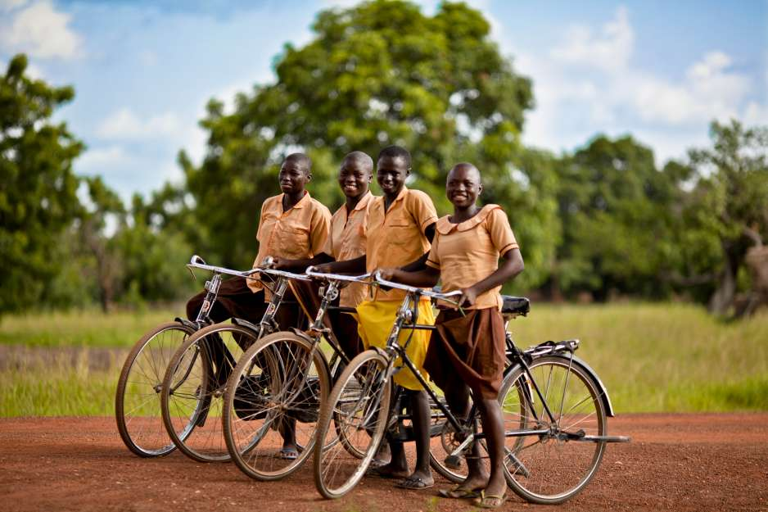
World’s Best Investment - Top 10 List
7. Education reduces rates of child marriage
8. Education empowers women
9. Education reduces harm to families from natural disasters and climate change
Educated Women and Girls
Are More Independent
Notes:
Education reduces rates of child marriage
A high-quality education for girls is a critical strategy to prevent child marriage and to mitigate the harmful consequences for girls who are already married. Child marriage is a global issue with millions of girls married every year around the world. Marriage frequently means an end to a girl’s schooling either in the run up to her marriage, or shortly afterward when a girl’s domestic duties increase as a result of her new role as a wife and mother. Child marriage not only curtails girls’ education but also puts girls at a higher risk of early pregnancy and complications during childbirth.
The dominant thinking has been that if girls are in school, they are at much less risk of child marriage. Although this is true, findings from various studies show that girls who are doing poorly in school, not learning well, and falling behind are sometimes being pulled out of school by their parents in order to marry. So again, the quality of education has important implications.
Let’s look at some numbers:
“In Sub-Saharan Africa, two-thirds (66 percent) of women with no education became child brides, versus 13 percent of those with secondary or higher education—a rate over five times higher.”
It is reported that for girls who dropped out of formal education in Syria, marriage might follow at ages as low as thirteen. Girls who continued their education, particularly higher education, were considered more likely to marry between the ages of twenty and twenty-seven.”
Education empowers women
In discussing women’s empowerment, the authors site Jeni Klugman, a researcher at the World Bank. Her report titled Voice and Agency: Empowering Women and Girls for Shared Prosperity, distills thousands of surveys and finds:
“Around the world, we see that better educated women are often better able to make and implement decisions and choices, even where gender norms are restrictive. In all regions, women with more education also tend to marry later and have fewer children. Enhanced agency is a key reason why children of better educated women are less likely to be stunted: educated mothers have greater autonomy in making decisions and more power to act for their children’s benefit”.
Klugman defines agency as “the ability to make decisions about one’s own life and act on them to achieve a desired outcome, free of violence, retribution, or fear.” Among the studies they cite they report:
that 43 percent of women without an education have no say in decisions about visits to friends and family, compared with 17 percent of those with a higher education.
“In South Asia, the Middle East, and North Africa, women with more education are less likely to have to ask their husband’s or family’s permission to seek medical care.”
Education reduces harm to families from natural disasters and climate change.
Around the world, women with higher levels of education appear to be more resilient in the face of crisis. They are better able to prepare for, adapt to, and bounce back from disasters. This resilience extends to their children and families.
With the increasing attention to climate change, extreme weather, and natural disasters, a number of recent studies have examined the social and economic factors that are associated with reducing vulnerability, especially for adolescent girls (Swarup et al. 2011; Van der Gaag 2013). Female education has emerged, in the words of one rigorous study, as “the single most important social and economic factor associated with a reduction in vulnerability to natural disasters.”

Slide 10
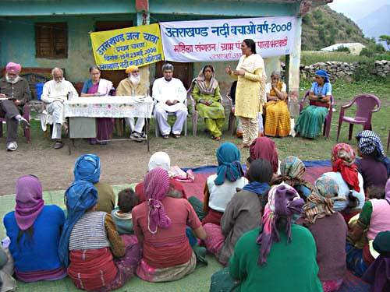
World’s Best Investment - Top 10 List
10. Education increases women’s political leadership
Notes:
Education give women the skills they need to take on leadership roles in public life. Better-educated women are more likely to participate in volunteer and elected decision-making bodies across all levels. In those roles, studies suggest that they are much more likely to advocate for decisions and policy that benefit family and community life, such as improved social services.
Women in leadership positions are important role models for both young girls and for changing public opinion about the roles women can fill in society. For example...
In villages where council positions were reserved for women, the proportion of parents who believed that their daughter’s occupation should be determined by her in-laws declined from 76 to 65 percent… showing how parents’ mindsets about their daughters improved with more female leadership in rural councils.

Slide 11
World’s Best Investment - Top 10 List
Education increases economic growth
Education leads to better wages and jobs for women
Education saves the lives of children and their mothers
Education reduces rates of HIV/AIDS and malaria
Education leads to smaller and more sustainable families
Education results in healthier and better-educated children
Education reduces rates of child marriage
Education empowers womens
Education reduces harm to families from natural disasters and climate change
Education increases women’s political leadership
Notes:
Here is a recap of the top 10 reasons to invest in women’s and girls’ education.
What’s next now that we know why investing in girls’ education is truly worthwhile both economically and socially?

Slide 12
What’s Next… Interventions That Work
1. Interventions that help make schools affordable
2. Interventions that help girls overcome health barriers
3. Interventions that reduce the time and distance to get to school
4. Interventions that make schools more girl-friendly
5. Interventions that improve school quality
6. Interventions that increase community engagement
7. Interventions that sustain girls’ education during emergencies
Notes:
I think the next logical question is to know where and how to invest money and resources, to make it count most.
The authors delve into that in chapter 4… here is quick look at the seven areas they consider critical:
Making schools affordable
Helping girls overcome health barriers
Reducing the time and distance to get to school
Making schools more girl-friendly
Improving school quality
Increasing community engagement
Sustaining girls’ education during emergencies
This we will cover this in detail another time.

Slide 13
Empowering Women and Girls through Knowledge and Skills
Tricia R. Saur, Target Chair
Target@fawco.org
Wikimedia Commons
Notes:
Thank you!

