Slide 1

Welcome to FAWCO!
Empowering Women Worldwide

Slide 2
What is FAWCO ?
Global network of 64 clubs in 33 countries on 6 continents
Over 12,000 individual members
UN-accredited NGO (1995) with special consultative status to ECOSOC* (1997)
FAWCO is the oldest and largest network of independent, volunteer organizations representing private-sector American citizens overseas.
* United Nations Economic and Social Council

Slide 3



The Three Faces of FAWCO
www.fawco.org
www.fausa.org
www.fawcofoundation.org

Slide 4

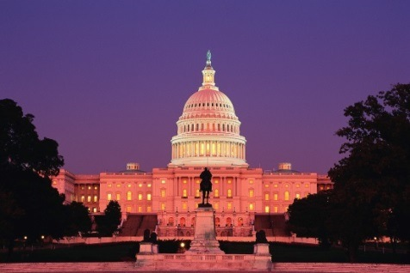
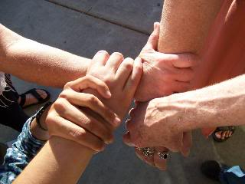

FAWCO’s Four Pillars
Global Issues
Member Club Support
US Issues
Philanthropy

Slide 5
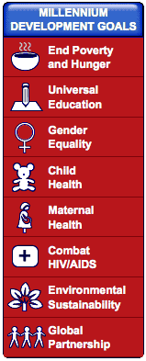
FAWCO and the UN
United Nations
FAWCO is a UN NGO with consultative status to the UN Economic and Social Council (ECOSOC).
UN Reps in New York, Geneva, Vienna, Athens.
Represented at meetings of the Committee on the Status of Women.
Your voice at the UN.
UNliaison@fawco.org

Slide 6




Global Issues Task Forces
FAWCO’s 4 Areas of Focus
Education, Environment, Health, Human Rights
education@fawco.org
environment@fawco.org
health@fawco.org
humanrights@fawco.org

Slide 7

Target Program
Target Programs include issue education and awareness, and fundraising for a specific project.
Target Program 2013-2016: Human Rights for Women
Target Project: Free the Girls helps survivors of trafficking
Target Water Project -- Tabitha Wells for Clean Water in Cambodia (2009-2013) -- raised over $165,000 and purchased water wells benefiting over 1,500 rural families.
target@fawco.org

Slide 8

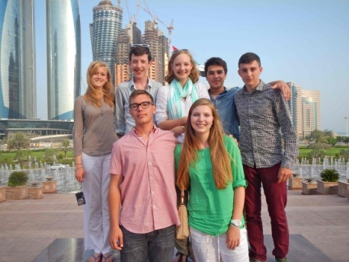
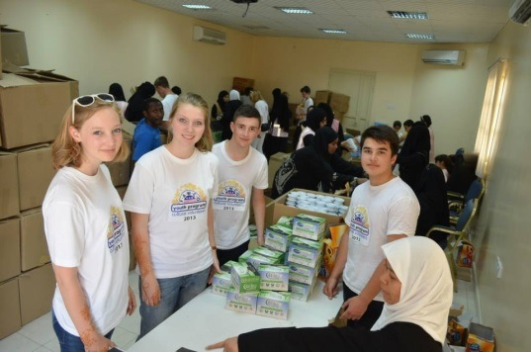
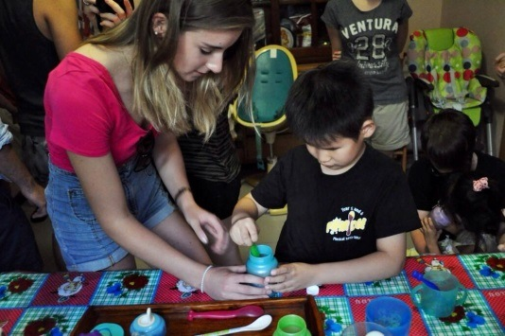
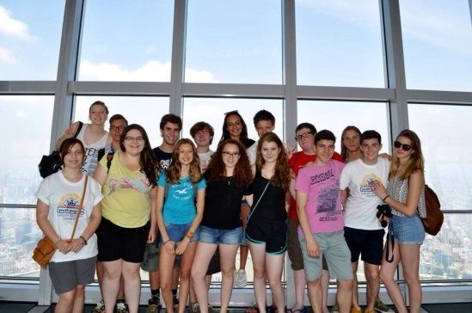
FAWCO Youth Program
To promote cross-cultural understanding and philanthropy in FAWCO youths
Cultural Volunteers Program, FAWCO Youth Ambassador, FAWCO UN Youth Reps
Promote Partner Youth Programs
  The FAWCO Foundation Education Awards
  Clements Expat Youth Scholarship
  Eleanor Roosevelt Girls Leadership Worldwide
Promote UN Youth Initiatives
fawcoyouth@fawco.org
Inaugural Cultural Volunteers Program
Dubai, July 2013
Cultural Volunteers Program in Shanghai
July 2014

Slide 9

Member Club Support
Sharing ideas and experiences through:
Club Development Workshops
Best Practices Library
Conferences (annual and regional)
FAWCO website & Facebook groups
Global networking
vp-memberclubs@fawco.org

Slide 10
What’s in it for you and your club
Global network to share ideas, experiences and best practices
Education awards for you and your children/grandchildren
Make a difference on issues and philanthropy on a global basis
Part of worldwide community of overseas Americans – advocacy on voting rights, citizenship rights, taxation and banking concerns
Gravitas: being part of a UN-accredited NGO which is active in policy-building at the UN gives credibility and clout!
Avenues for engagement, friends worldwide, inspiration

Slide 11
What YOU can do
“Like” FAWCO on Facebook
Register on FAWCO website / subscribe to FAWCO publications
Apply for Education Awards / nominate a Development Grant
Join a Task Force or Committee
Share a Best Practice
Attend conferences
Spread FAWCO Fever within your club!

Slide 12


FAWCO
Empowering Women Worldwide
Empowering Your Club
Empowering YOU

